Slide 1

Annafi Mirza & Hashim Khan
NewsFlash
Forecasting Investment News
CSC431 - Spring 2026
Dr. Hien Nguyen
Final Presentation

Slide 2
Presenters
Annafi Mirza
Lead Project Design
Computer Science, Data Science & Artificial Intelligence
Hashim Khan
Lead Technical Design
Computer Science, Mathematics
NewsFlash
Annafi Mirza & Hashim Khan

Slide 3

Table of Contents
Why NewsFlash?
Functional Requirements
Non-Functional Requirements
System Constraints
Evolutionary Requirements
Use Cases & Diagrams
System Model
System Architecture Design
Design Patterns
Mockup Interface + Code
Conclusion
Resources & QnA
NewsFlash
Annafi Mirza & Hashim Khan

Slide 4

Why NewsFlash?
Investment news and market predictions in one place
Latest headlines and trends across the stock market
Insights by industry, commodity, or security
Prediction models for short-term market forecasting
NewsFlash
Annafi Mirza & Hashim Khan

Slide 5

Functional Requirements
Scrape headlines.
Rate each headline.
Compute summary stats.
Display summary stats.
Train models to predict ratings.
Predict next week’s daily ratings.
Display predictions.
NewsFlash
Annafi Mirza & Hashim Khan

Slide 6
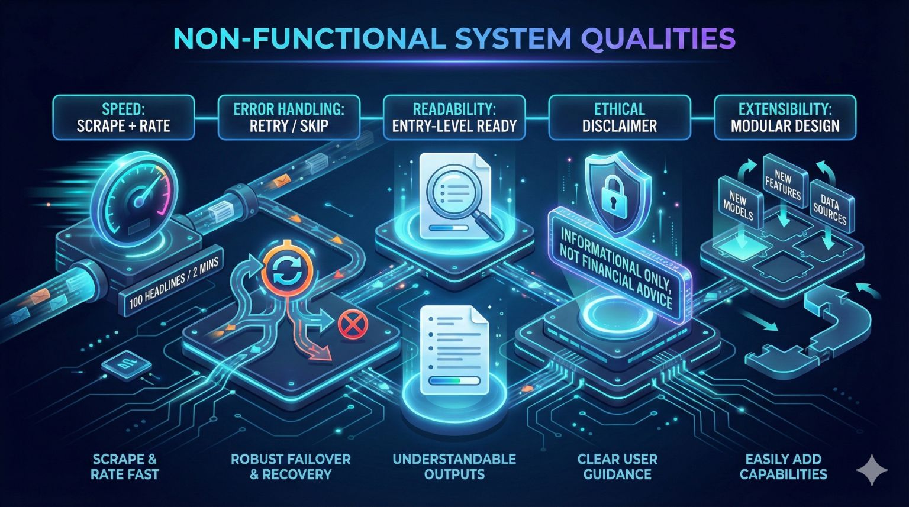
Non-Functional Requirements
Speed
Error Handling
Readability
Ethical Disclaimer
Extensibility
NewsFlash
Annafi Mirza & Hashim Khan

Slide 7
System Constraints
Tools / Platforms
Software: Python 3.x
Database: SQLite
Web scraping: BeautifulSoup + Selenium
LLM ratings: Gemini API + OpenRouter
Prediction: scikit-learn + statsmodels
Deployment / Environment
Internet connection
Distributed via GitHub
Database capped at ~1GB
Memory capped at 4GB RAM
NewsFlash
Annafi Mirza & Hashim Khan

Slide 8
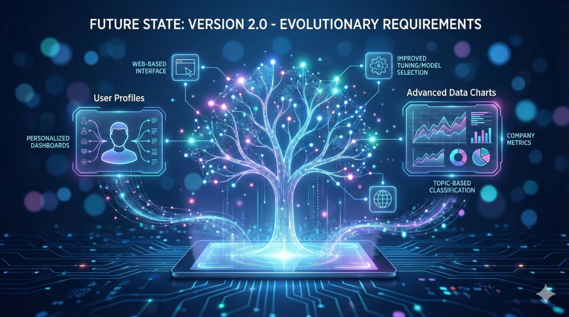
Evolutionary Requirements
Future Functional
Multiple ratings per headline.
Personalized dashboards.
More company metrics.
Web-based interface.
Prediction modeling in the cloud.
Future Non-Functional
Improved speed, accuracy, & memory through better tuning/model selection.
NewsFlash
Annafi Mirza & Hashim Khan

Slide 9
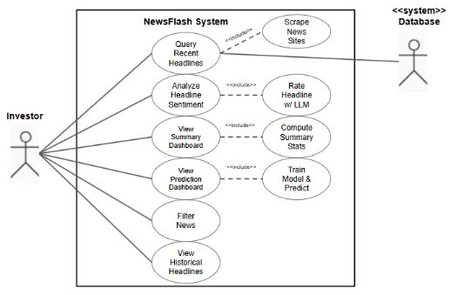
Use Cases & Diagrams
NewsFlash
Annafi Mirza & Hashim Khan

Slide 10
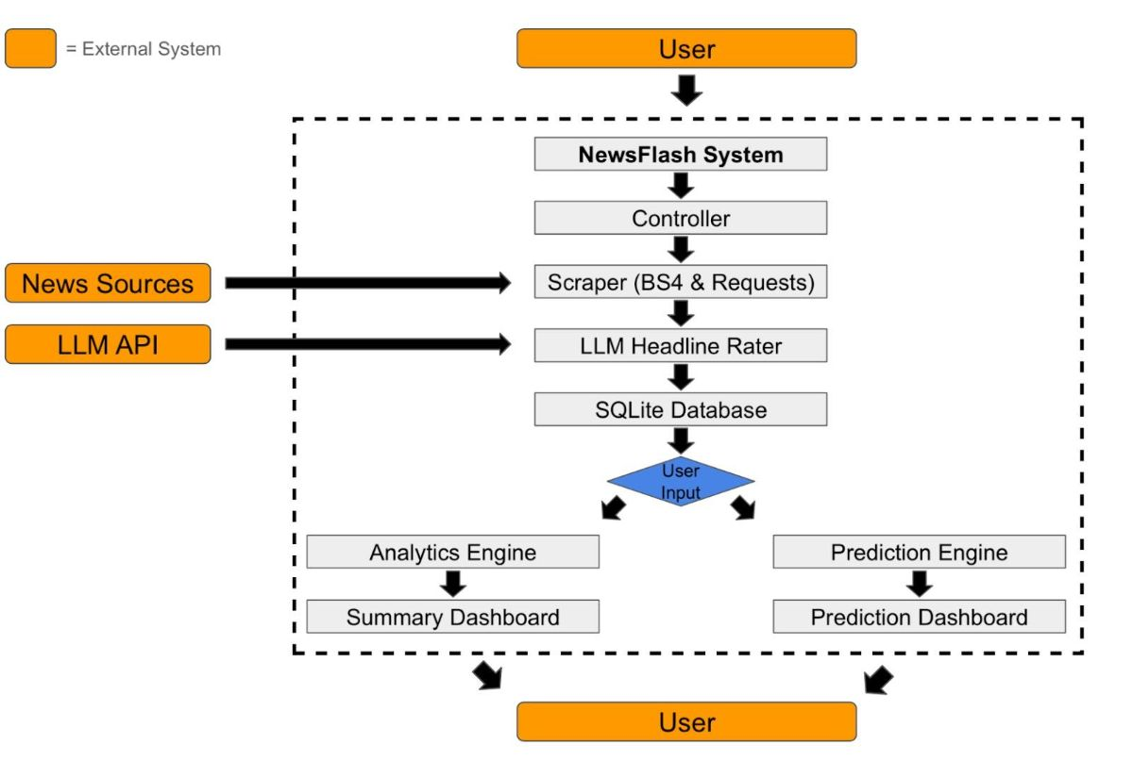
System Model
NewsFlash
Annafi Mirza & Hashim Khan

Slide 11
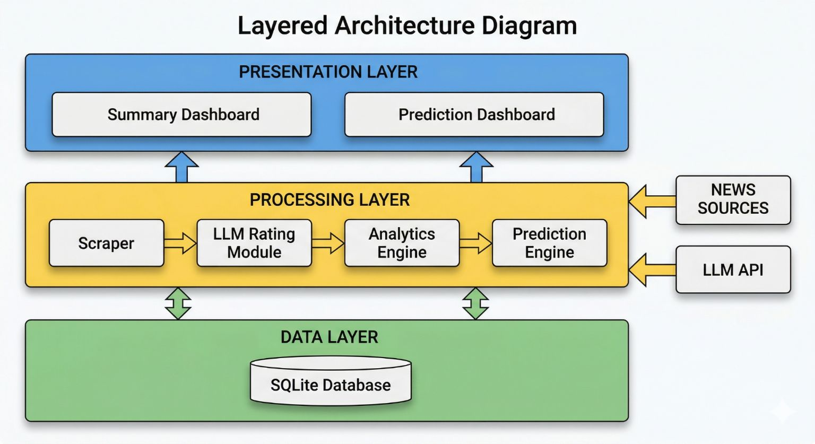
System Architecture Design
NewsFlash
Annafi Mirza & Hashim Khan

Slide 12
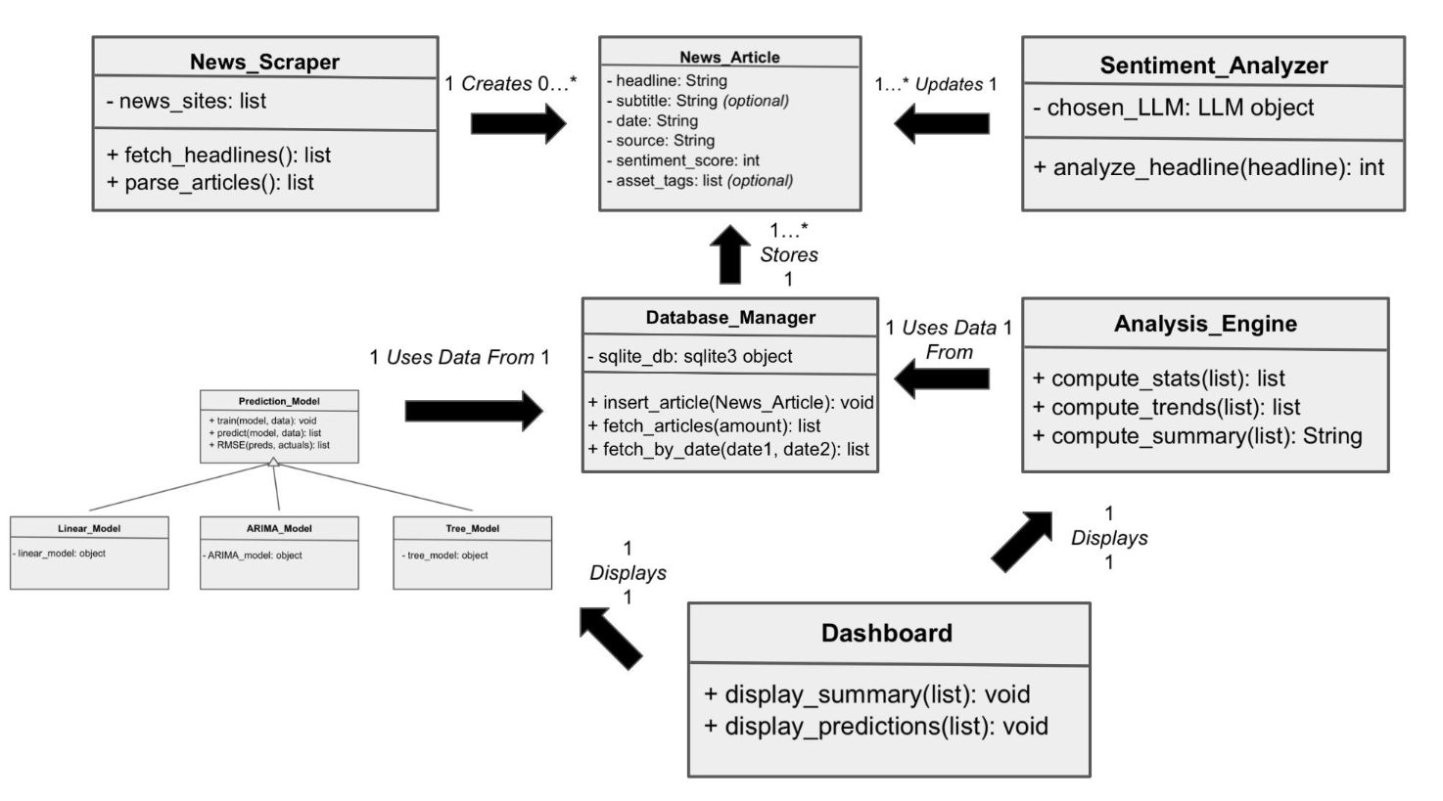
Class Diagram
NOTE: The arrows signify communication, NOT inheritance.
NewsFlash
Annafi Mirza & Hashim Khan

Slide 13
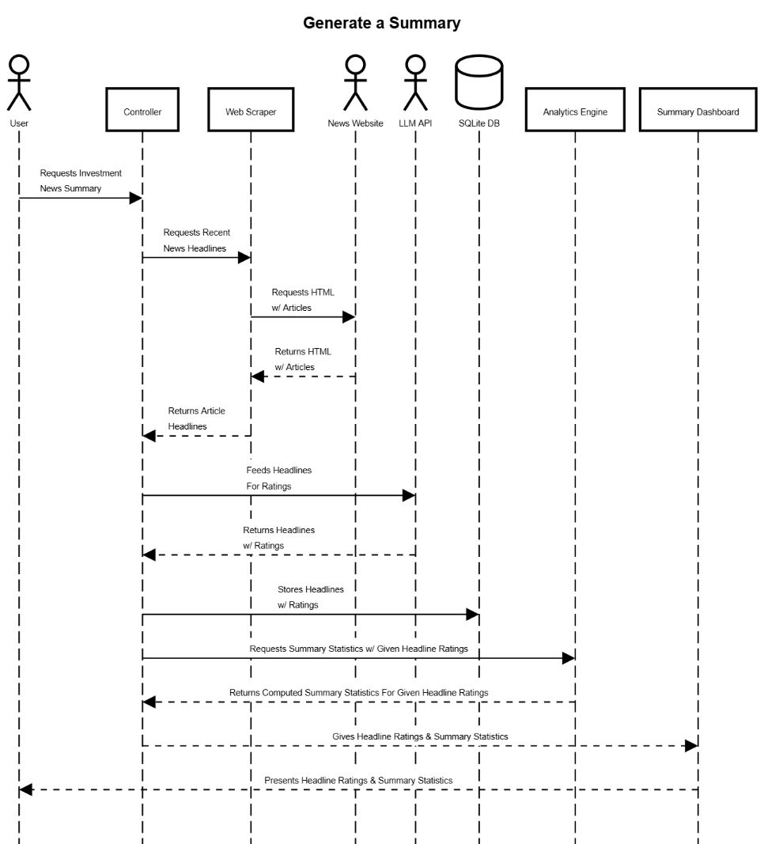
Sequence Diagrams
NewsFlash
Annafi Mirza & Hashim Khan

Slide 14
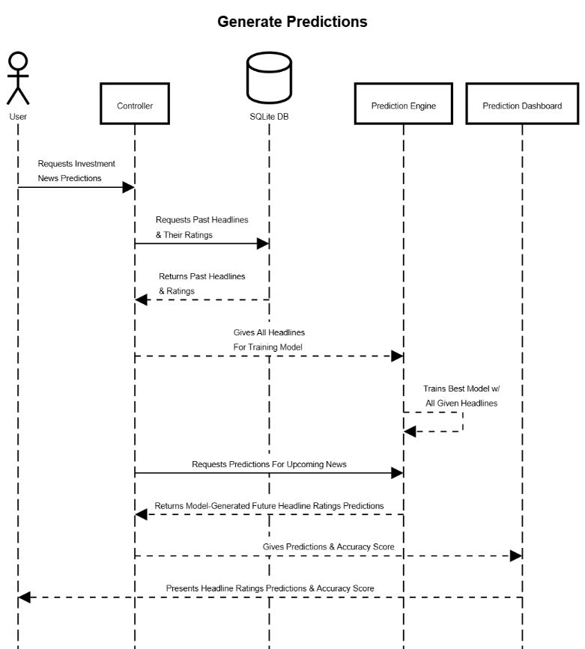
Sequence Diagrams
NewsFlash
Annafi Mirza & Hashim Khan

Slide 15
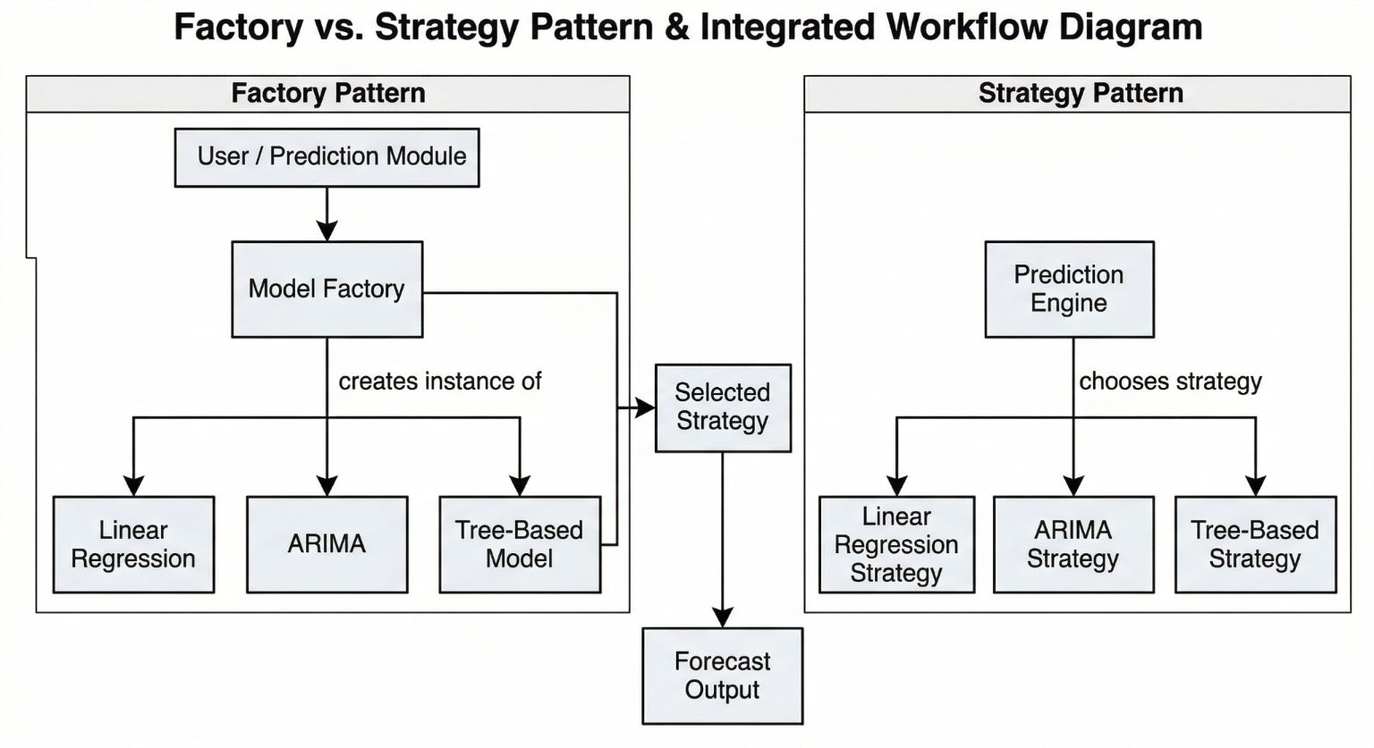
Design Patterns
NewsFlash
Annafi Mirza & Hashim Khan

Slide 16
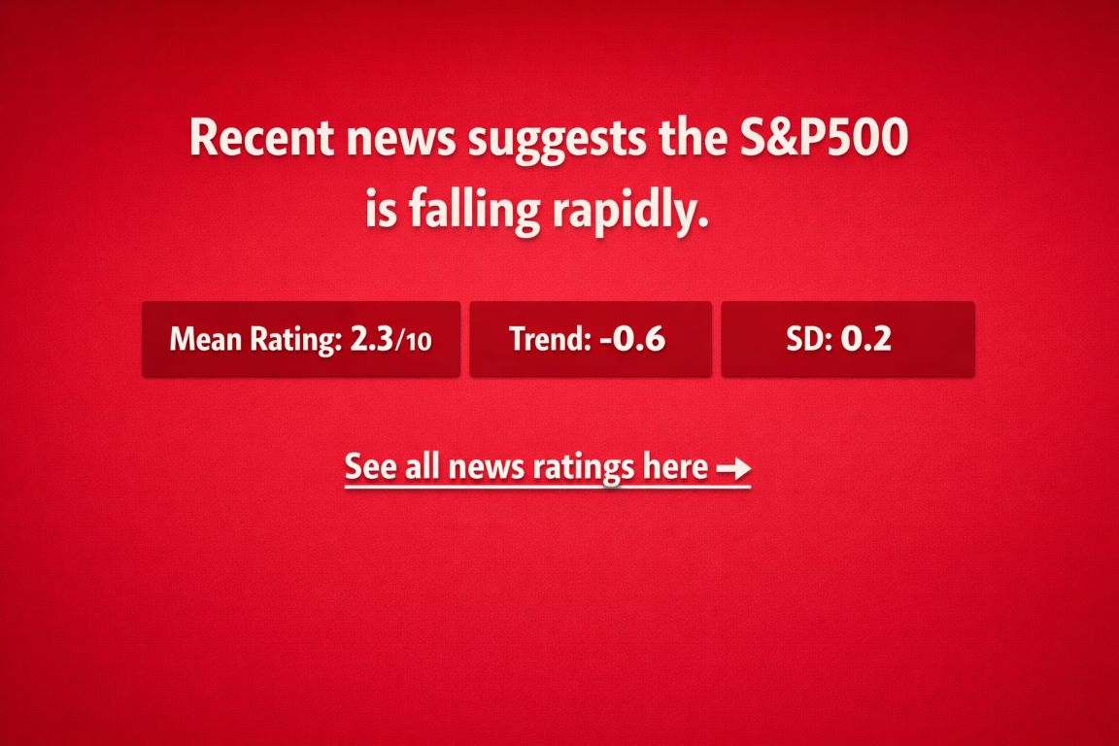
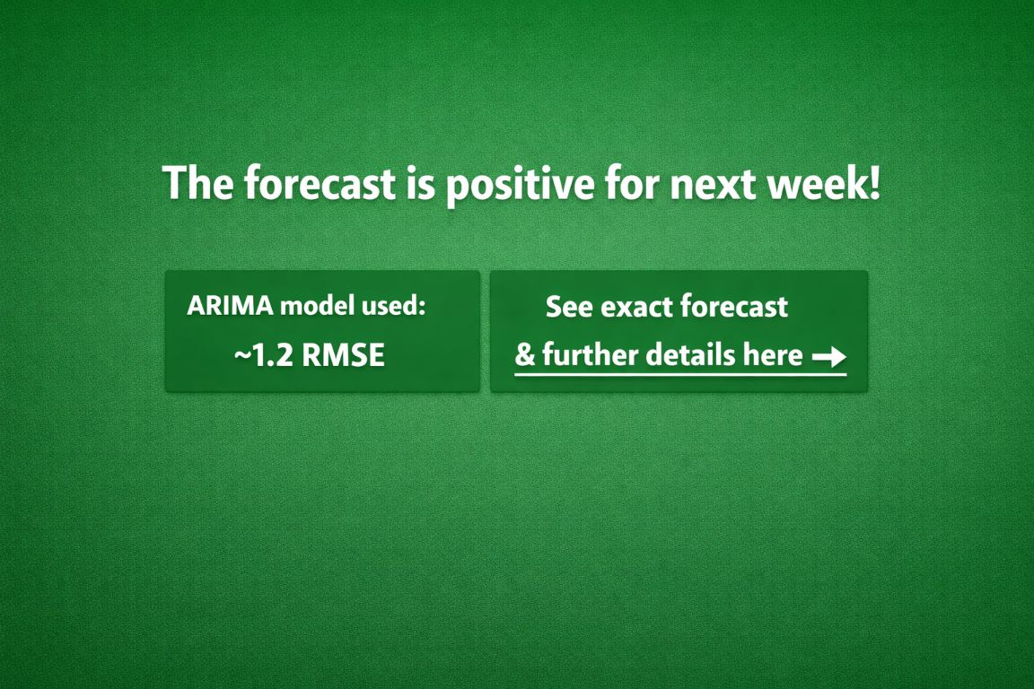
Mockup Interface
Examples of how our software’s GUIs can look like:
NewsFlash
Annafi Mirza & Hashim Khan

Slide 17
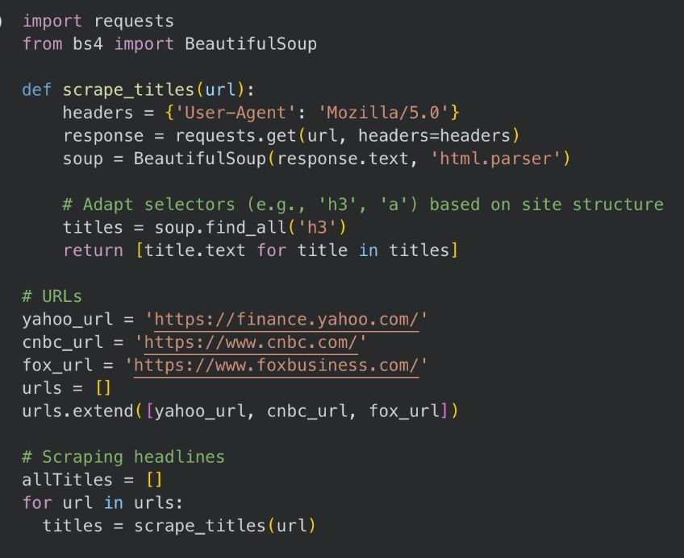
Mockup Interface - Code
Scraping News Headlines:
NewsFlash
Annafi Mirza & Hashim Khan

Slide 18
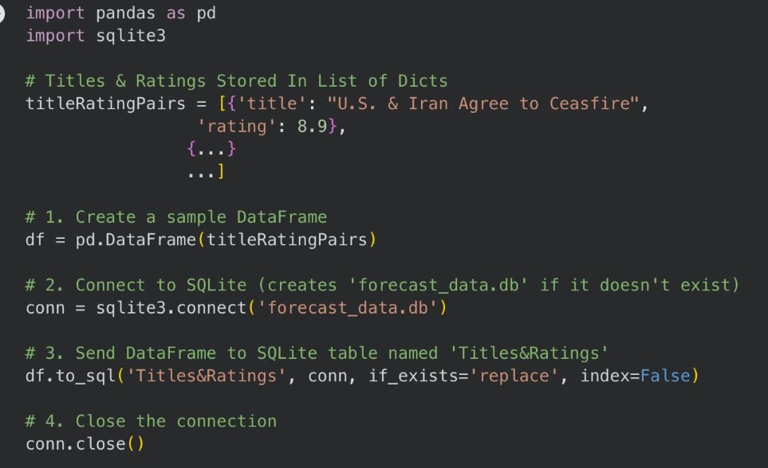
Mockup Interface - Code
Storing Headlines Into Database:
NewsFlash
Annafi Mirza & Hashim Khan

Slide 19
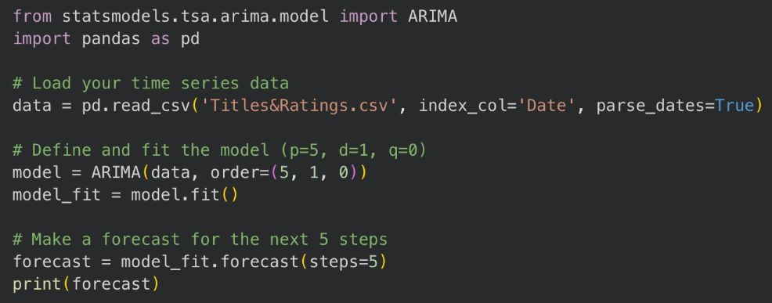
Mockup Interface - Code
Training & Predicting w/ ARIMA Model:
NewsFlash
Annafi Mirza & Hashim Khan

Slide 20
Conclusion
Understand news-driven market conditions
Explore insights across industries and assets
Forecast short-term trends with prediction models
Extend to personalization and richer data sources
NewsFlash
Annafi Mirza & Hashim Khan

Slide 21
Resources
Google CoLab: https://colab.research.google.com
SQLite Guide: https://sqlite.org/docs.html
Sequence Diagram Constructor: https://sequencediagram.org
NewsFlash
Annafi Mirza & Hashim Khan

Slide 22
QnA
Any Questions?
NewsFlash
Annafi Mirza & Hashim Khan

